Slide 1

AVI-LV5
Indirect lightning test system
Notes:
NW

Slide 2


EMC Partner AG – the Swiss company
  EMC PARTNER AG
  Founded in 1994
  Swiss private company, headquarters in Laufen
  Largest choice of impulse generators
  Market leading supplier, reputed worldwide
  Development, production and testing in house
  Global network of representatives

Slide 3






EMC PARTNER provides conducted immunity test solutions for a broad range of sectors
Introduction
Industry & Household
Avionics
Components
Military
Renewable energy
Telecom

Slide 4

Contents
Introduction
DO-160G Section 22
AVI-LV5: technical specification
AVI-LV5: calibration setup and test setup examples

Slide 5

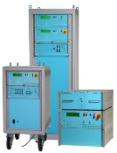
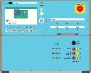
Introduction
EMC PARTNER sets the standard: 100+ systems for level 5 testing, 50+ systems for level 3 testing
Therefore: worldwide no. 1 supplier of indirect lightning test systems
Major aircraft manufacturers
  Airborne equipment manufacturers
  Test labs

Slide 6

Introduction
EMC Partner is worldwide # 1 in delivered test system for indirect lightning tests:
20+ years of experience and continuous improvement
Unique technology based on third generation solid state switches (no maintenance required)
Full compliant tests
Accurate, reproducible and reliable results

Slide 7



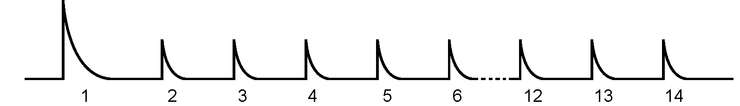
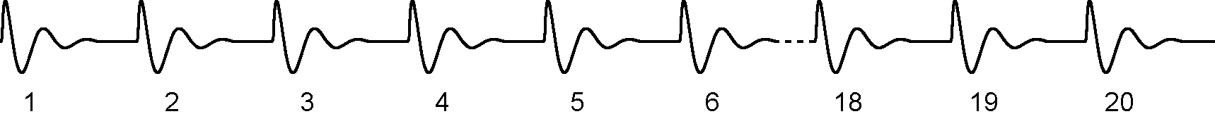
Signal types
DO-160 Section 22 requirements
Single stroke SS
Multiple stroke MS
Multiple Burst MB

Slide 8
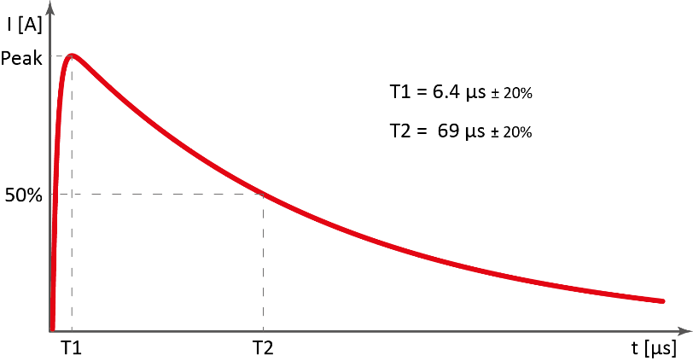
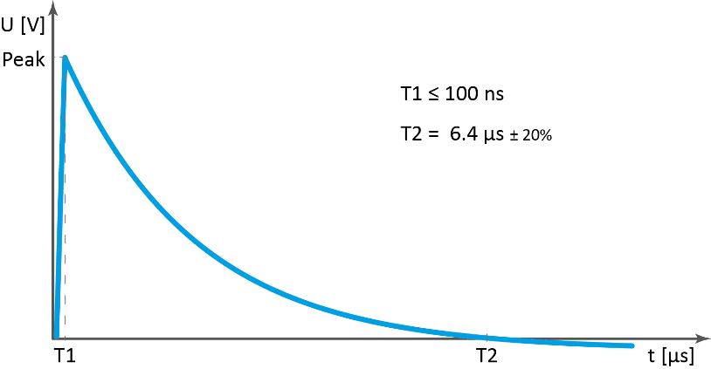
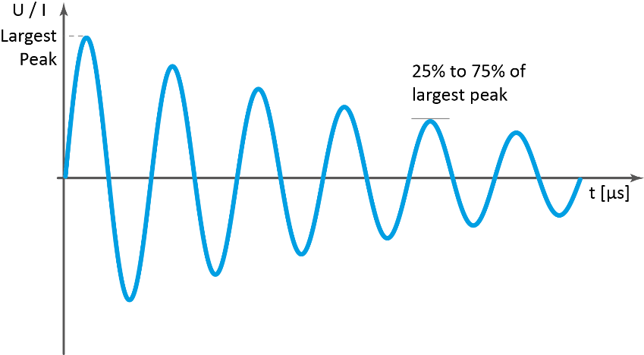
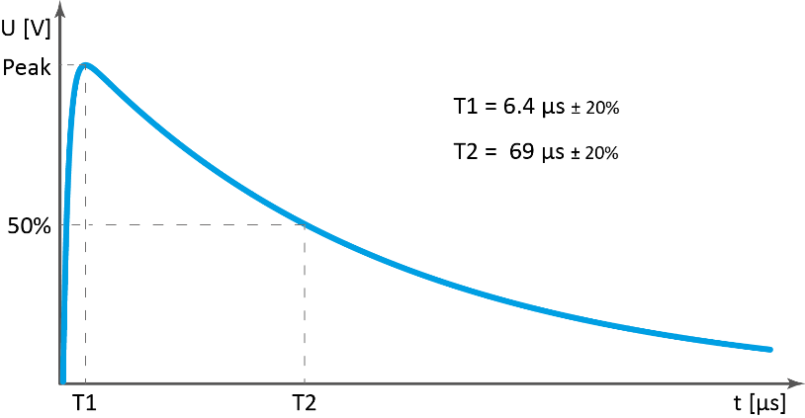
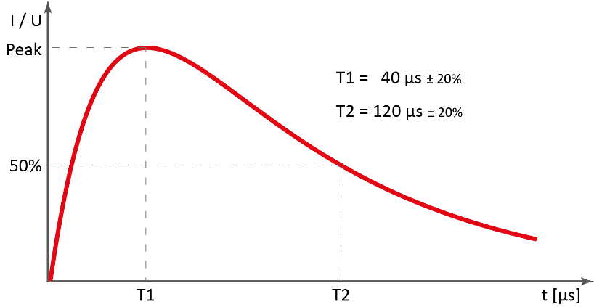
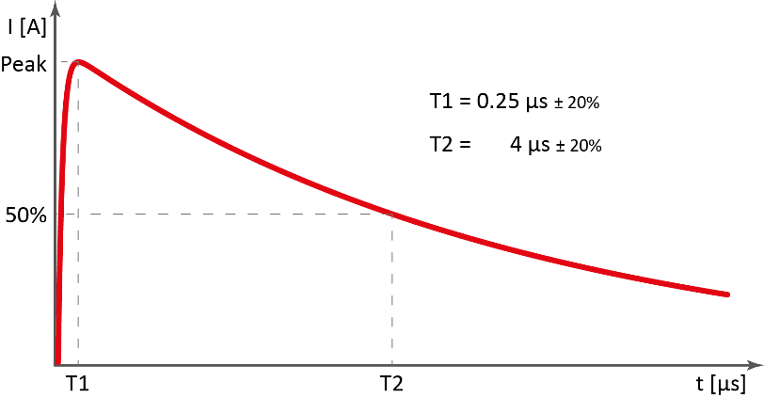
Waveforms current and voltage
DO-160 Section 22 requirements
WF1 | WF2 | WF3
WF4 | WF5 A / B | WF6
A
B
T1 = 50 µs ± 20%
T2 = 500 µs ± 20%

Slide 9

Requirements for Pin Injection (PIN) and Cable Bundle (CB) tests
DO-160 Section 22 requirements
Test type | Signal | WF1 | WF2 | WF3 | WF4 | WF5A | WF6
Pin injection | SS | no req | no req | L5 | L5 | L5 | no req
 | MS | no requirement
 | MB
Cable bundle | SS | L5 | L5 | L5 | L5 | L5 | no req
 | MS | L5 | L5 | L5 | L5 | L5 | no req
 | MB | no req | no req | L5 | no req | no req | L5

Slide 10
A fully-configured AVI-LV5 test system meets and exceeds all DO-160 Section 22requirements , including:
 Single Stroke, Multiple Stroke, Multiple Burst events
 Waveforms 1, 2, 3 (1 MHz and 10 MHz), 4, 5A, 5B and 6
 Pin injection and cable bundle applications as applicable
DO-160 Section 22 requirements

Slide 11
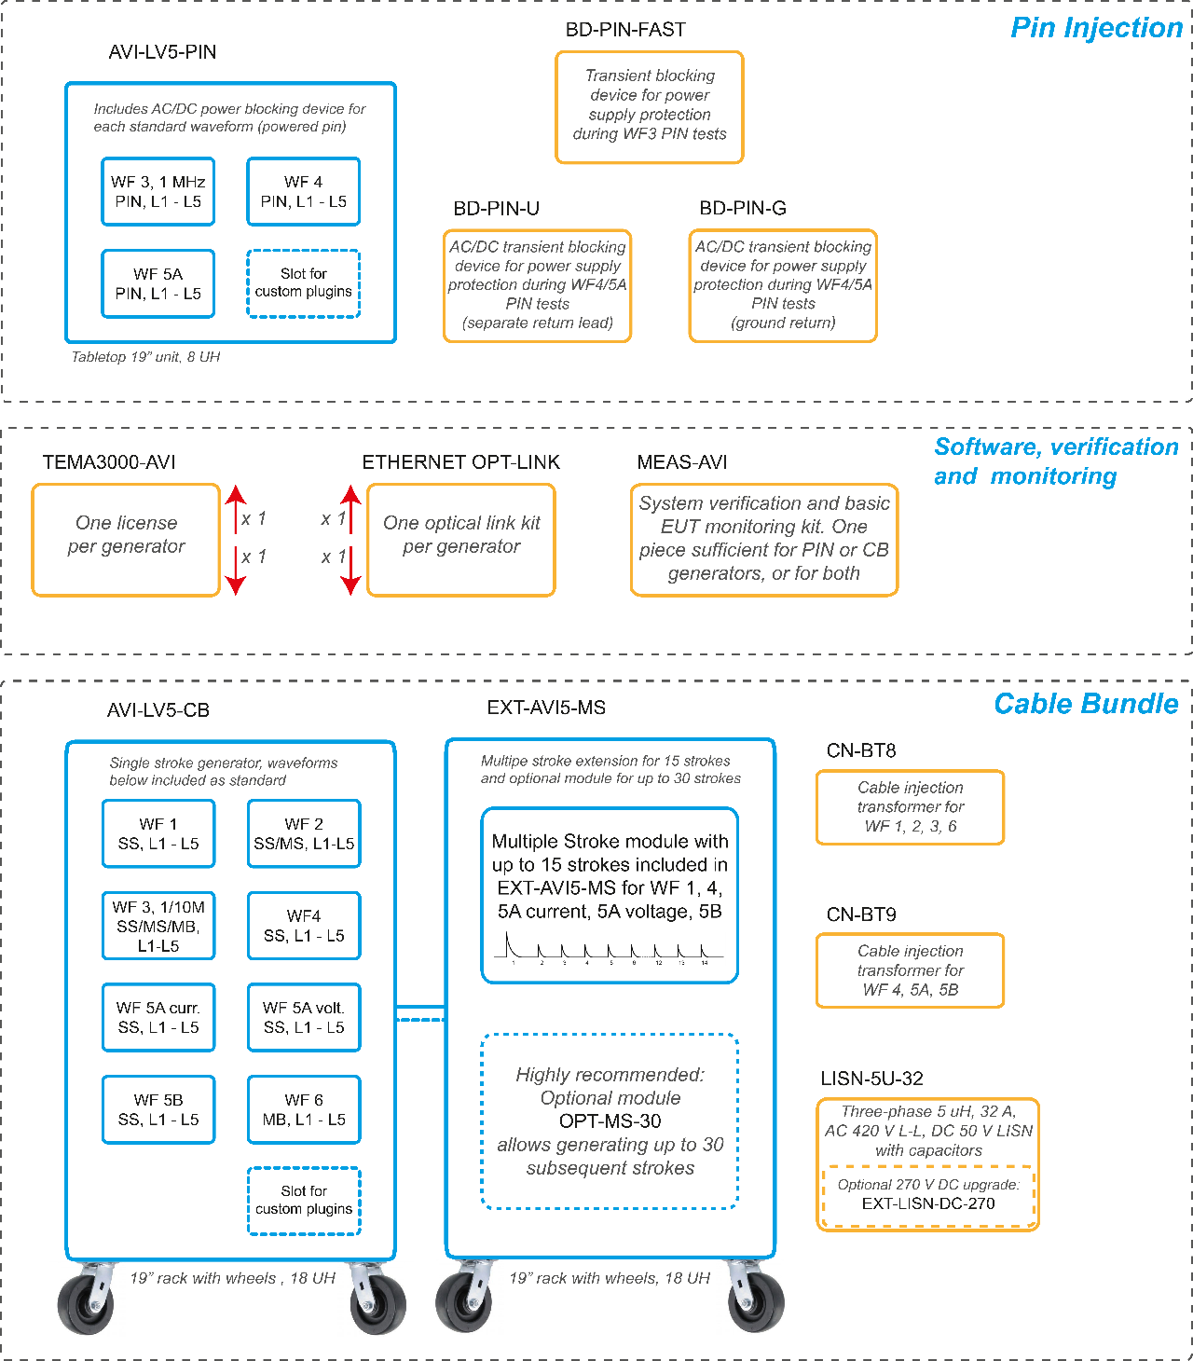
Application-based modularity
AVI-LV5
Possible to split between pin injection tests and cable bundle tests
Possible to maintain cost under control when only CB tests (or CS117) are required, and add later pin injection testing if needed
The 30 subsequent stroke capability is optional
270 V DC capability of LISN is optional
Power source transient blocking devices are optional (in case no power pins are tested)

Slide 12
Future-oriented characteristics
AVI-LV5
Design optimized to reach test level or limit level in basically all cases
Support for electrification of aircraft industry through higher EUT currents allowed through the injection transformer, pin injection generators internal protection up to 540 V DC and 230 V (50 – 800 Hz)
Simplified firmware and software upgrades at no additional cost during an estimated lifetime of at least 10 years
Open architecture allowing expansion of the system, with features like for example customer WF 3 frequencies (subject to prior check for each possible new feature by EMC PARTNER)

Slide 13
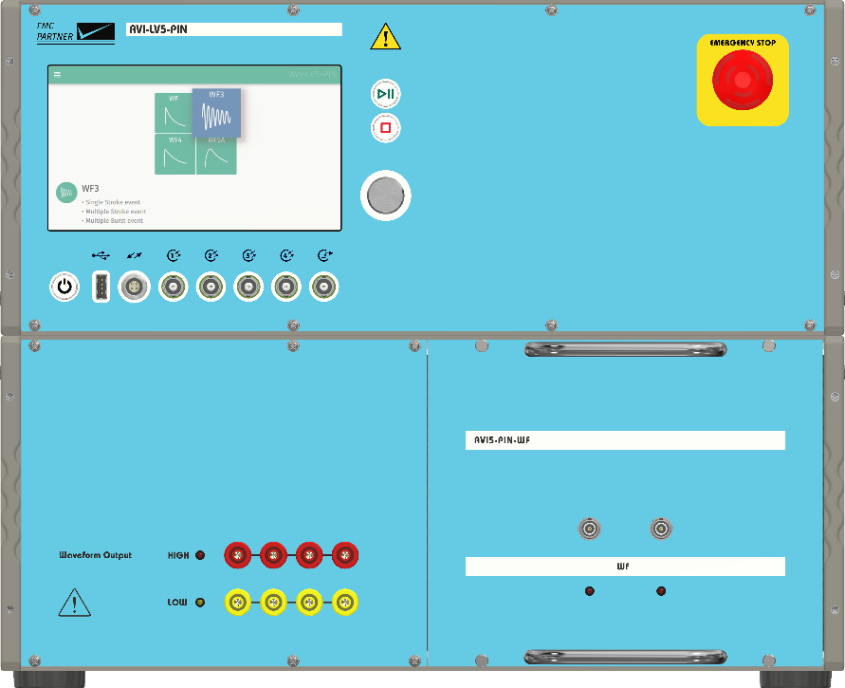

Cutting-edge technology, outstanding performance
AVI-LV5
Touchscreen control: reduced complexity and steep learning curve
1.2 GHz quad-core processor, 1 Gbps Ethernet connection
Fast and simple firmware updates

Slide 14
Pin test highlights and new features
AVI-LV5
Table-top unit, 19" 8UH unit for levels 1 – 5, waveforms 3 (1 MHz), 4, 5A, easy to move around the lab
Automatic synchronization on power peak up to 800 Hz with no extra cables
EUT voltage and frequency displayed on the screen during test

Slide 15
Pin test highlights and new features
AVI-LV5
Built-in power blocking devices to protect the generator during powered pin tests : max AC 230 V / 800 Hz, DC ± 540 V
The system supports direct injection or ground injection methods with external (optional) transient blocking devices or bypass circuitry (selection of method should consider the type of EUT supply)
Open architecture with slot for interchangeable/custom plugins

Slide 16

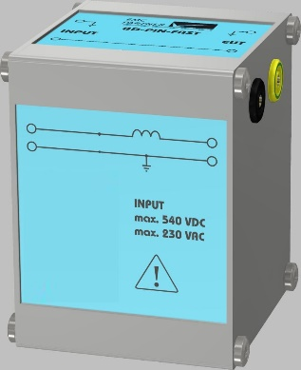
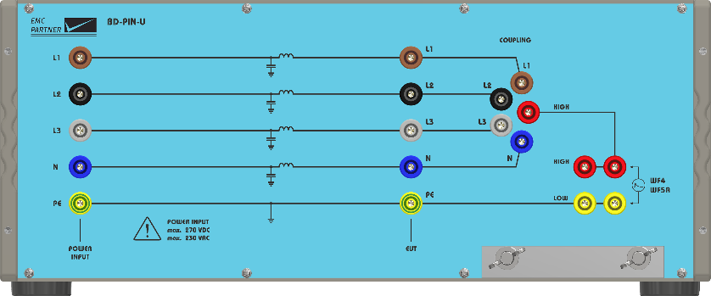
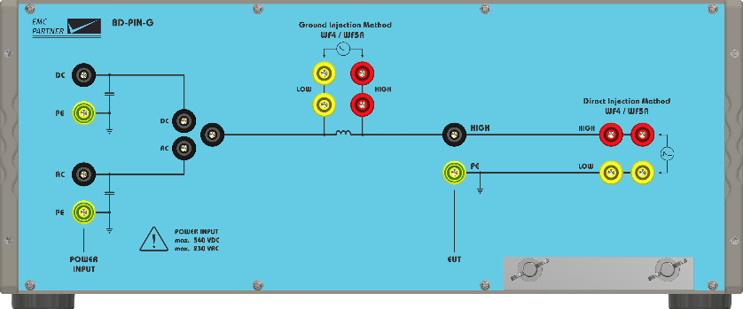
AVI-LV5
World’s first standard transient blocking devices and bypass circuitry for powered pins to protect power sources during the test are now available as options for AVI-LV5-PIN. Waveforms 3 (1 MHz), 4 and 5 A covered
World‘s first!
BD-PIN-FAST
BD-PIN-U
BD-PIN-G

Slide 17
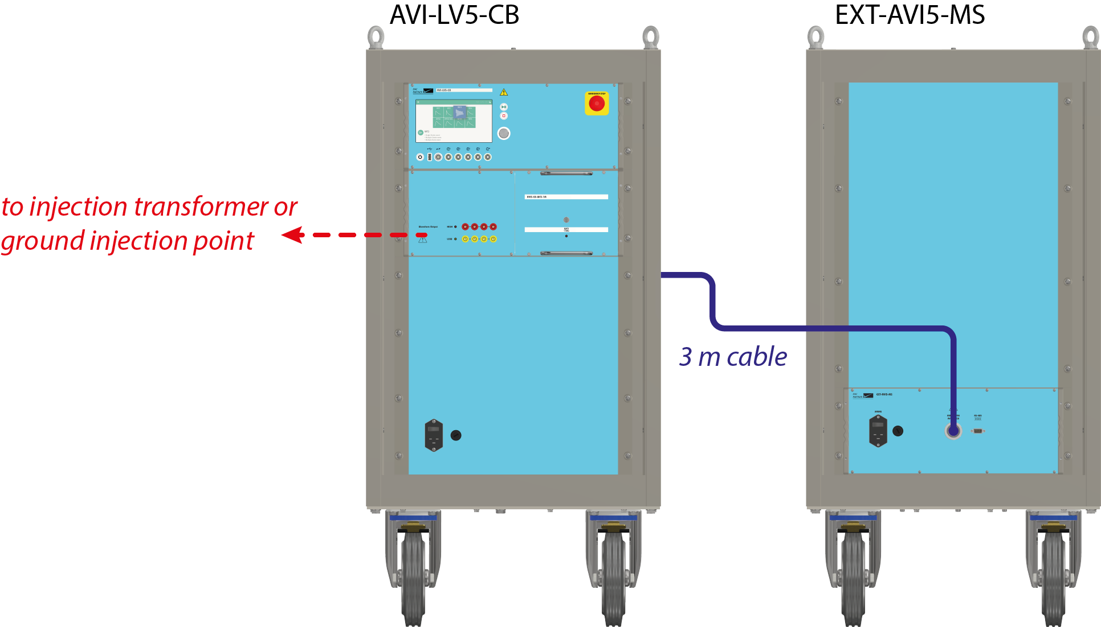
Cable bundle test highlights and new features
AVI-LV5
System architecture: AVI-LV5-CB Single Stroke generator (19” rack, 18 UH on wheels) and EXT-AVI5-MS Multiple Stroke (15 strokes) extension (19” rack, 18 UH on wheels) connected together
OPT-MS-30 can optionally extend subsequent stroke capability of EXT-AVI5-MS from 15 strokes to 30 strokes
Waveforms included in delivery either built-in or plugins: 1, 2, 3 (1 & 10 MHz), 4, 5A, 5A voltage, 5B, 6
Open architecture with slot for interchangeable/custom plugins

Slide 18
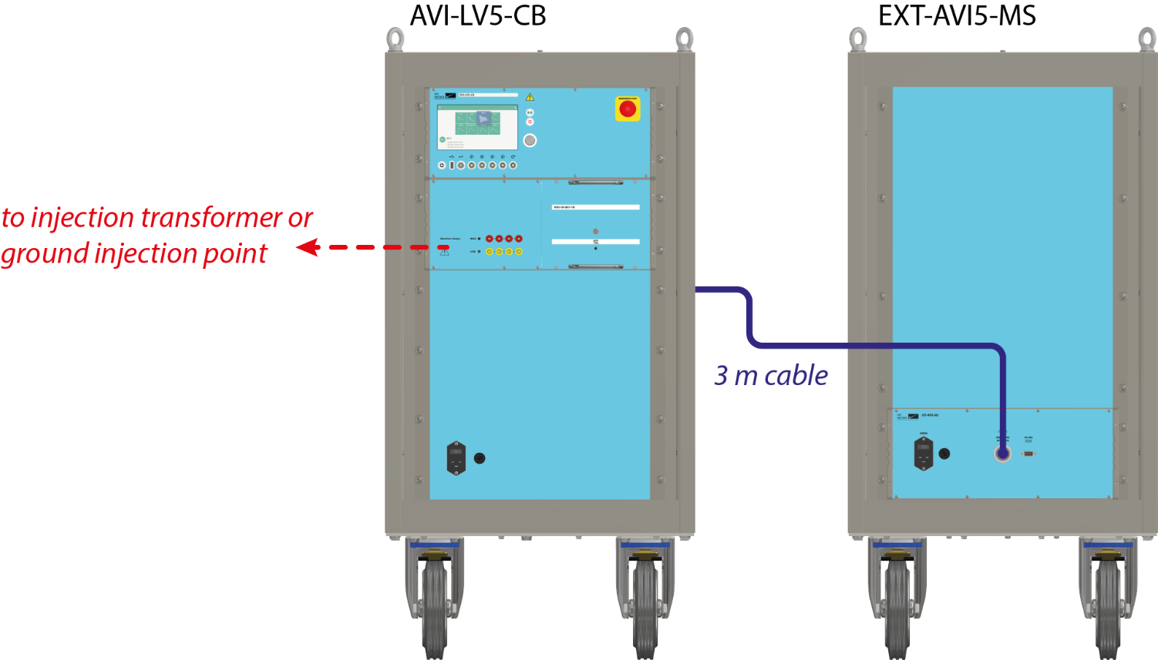
Cable bundle test highlights and new features
AVI-LV5
Ground injection EUT power:
WF 4: max. 30 A DC – 800 Hz
WF 5A, 5A voltage: max. 30 A DC – 800 Hz

Slide 19

Cable bundle test highlights and new features
AVI-LV5
Only two cable induction injection transformers for all waveforms, all test levels:
CN-BT8: Waveforms 1, 3 (1 & 10 MHz), 6 EUT current: max. 426 A @ DC-60 Hz, 32 A @ 800 Hz
CN-BT9: Waveforms 4, 5A, 5B EUT current: max. 426 A @ DC-60 Hz, 32 A @ 800 Hz
Waveform 5A voltage EUT current: max. 213 A @ DC-60 Hz, 16 A @ 800 Hz
Advantages:
High chances to reach either test level or limit level in all cases

Slide 20
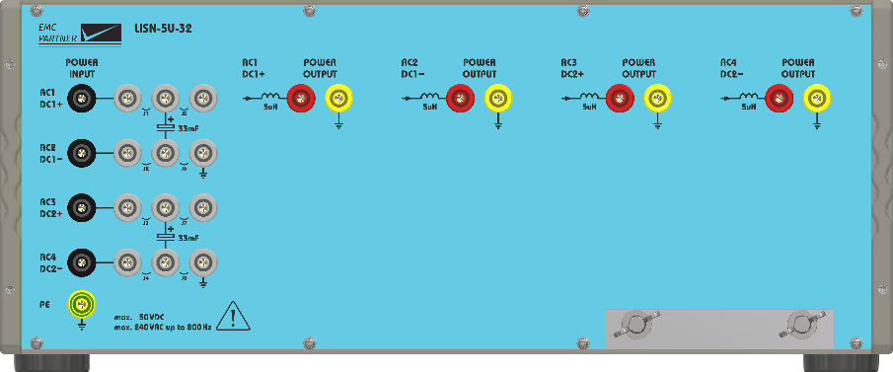
Cable bundle test highlights and new features
AVI-LV5
New three-phase LISNs with 5 µH per line, optional extensions up to DC 270 V line to line:
LISN-5U-32 (single & three phase, DC)
AC L-PE | 240 V (50-800 Hz)
AC L-L/N | 420 V (50-800 Hz)
DC L-L, L-PE | standard 50 V
Option DC (separate) | 270 V L-L/PE
AC/DC current | 32 A (/line or DC)
AC capacitors L-PE | 10 µF per line
DC capacitors L-PE | > 28 mF
Standards | DO-160 S22, CS117

Slide 21
Further new features
AVI-LV5
Enhanced kit for calibration and basic monitoring (one bundle) with included ISO 17025 calibrations
Optional TEMA3000-AVI software package with sequence, report and DSO control functionality (one license per generator)
Optional fiber link (10 meters) ensures galvanic decoupling of the generator from control computer
Flexible system architecture allows upgrades to meet aircraft manufacturers’ additional requirements as well as new requirements

Slide 22
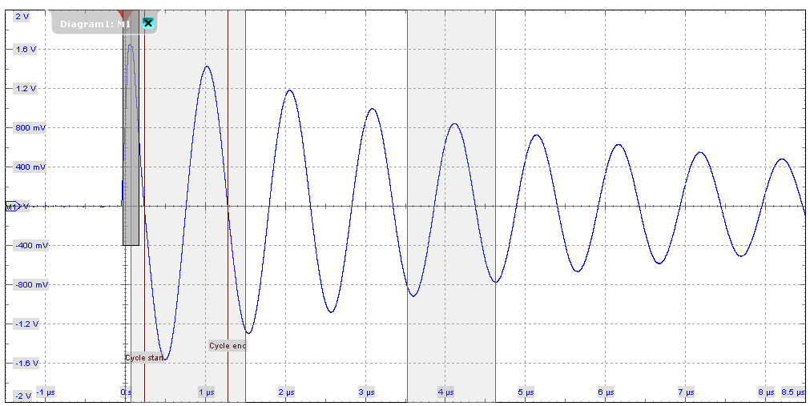
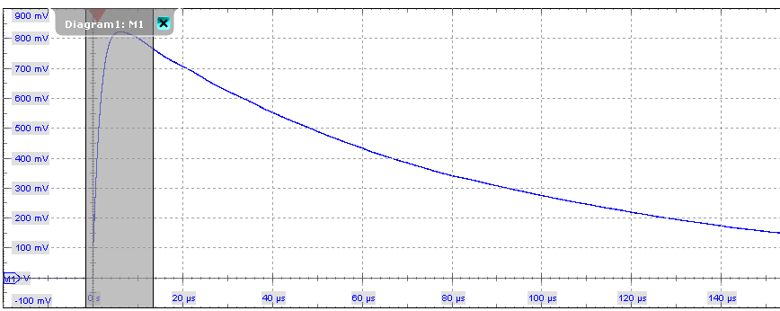
Excellent waveforms
AVI-LV5
Waveform 3 (1 MHz) Pin 3200 V
Waveform 4 Pin 1600 V

Slide 23
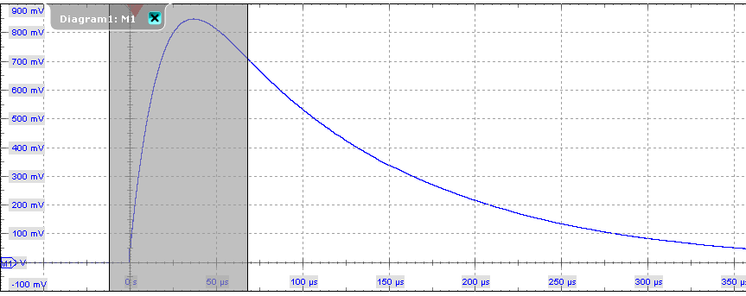
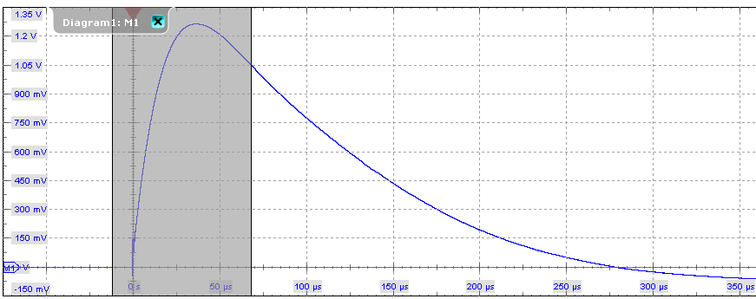
Excellent waveforms II
AVI-LV5
Waveform 5A Pin 1600 V
Waveform 5A Pin 2400 V with BD-PIN-G

Slide 24
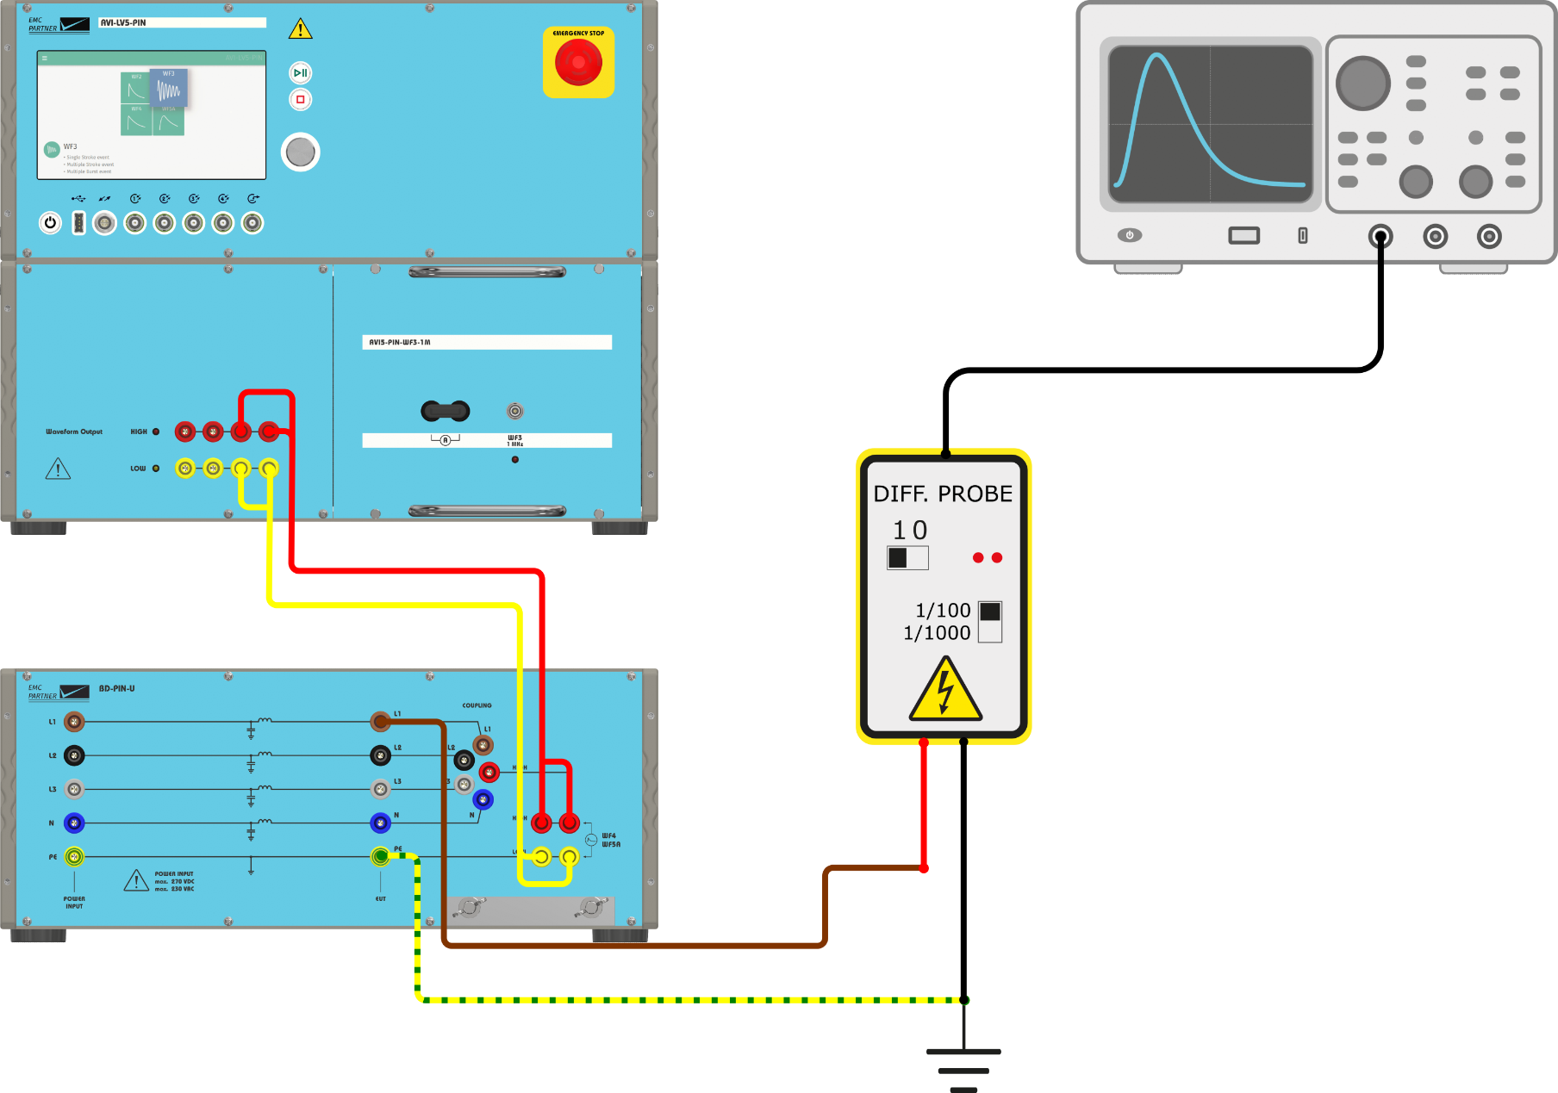
Calibration setup: pin injection – power pin, WF 4 / WF 5A, ungrounded return lead
AVI-LV5: calibration setup and test setup examples
Voltage calibration

Slide 25
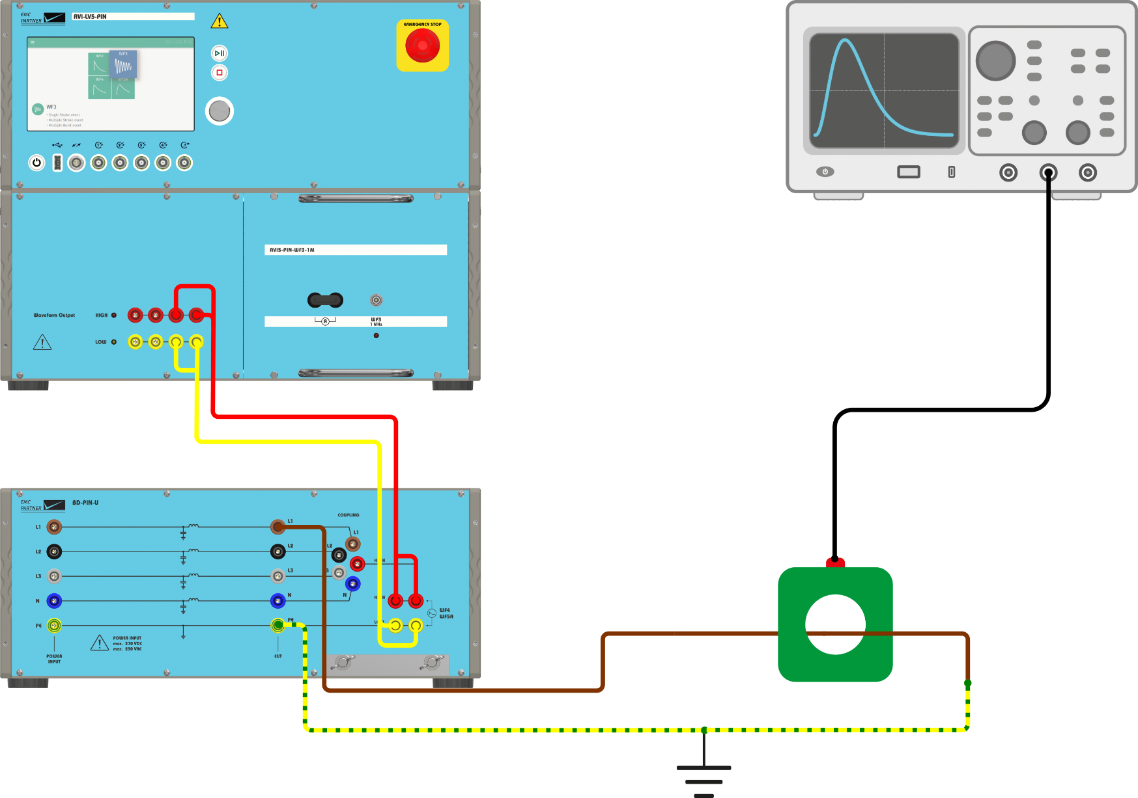
Calibration setup: pin injection – power pin, WF 4 / WF 5A, ungrounded return lead
AVI-LV5: calibration setup and test setup examples
Current calibration

Slide 26
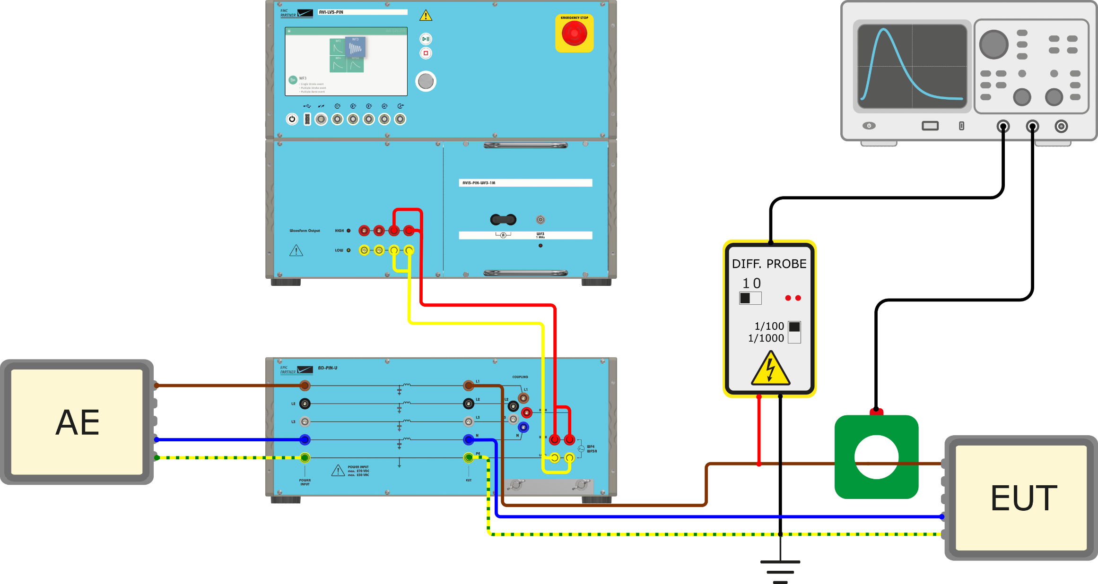
Test setup: pin injection – power pin, WF 4 / WF 5A, ungrounded return lead
AVI-LV5: calibration setup and test setup examples
Test setup

Slide 27
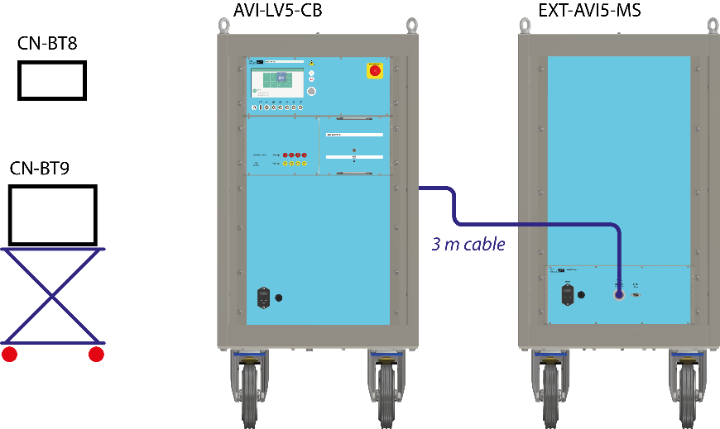

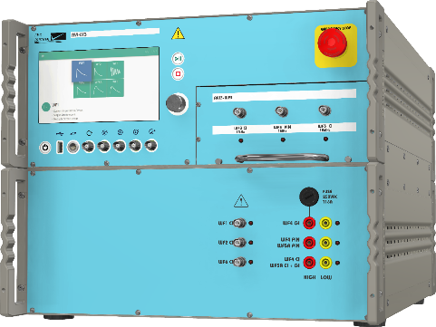
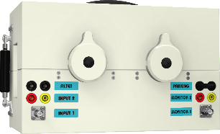
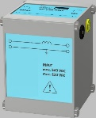
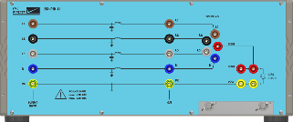
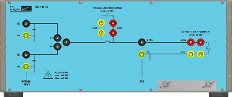
Two main solutions for indirect lightning tests from EMC PARTNER Switzerland
AVI-LV3 & AVI-LV5
AVI-LV3
AVI-LV5 new!
Ultra-compact, Sec. 22 level 3 and CS117 internal eq. level
WF 1, 2, 3 (1 & 10 MHz), 4, 5A, 6 in one unit (Pin, CB as applicable)
Not upgradeable to level 5 or external eq. level
Sec. 22 level 5 and CS117 internal and external eq. level
WF 1, 2, 3 (1 & 10 MHz), 4, 5A current, 5A voltage, 5B current, 6 (Pin, CB as applicable)
Latest innovations like power source protection during Pin test available

Slide 28
Competence and assistance from EMC PARTNER & official representatives
AVI-LV3 & AVI-LV5
Technical assistance throughout project development process
Installation, training, long-term support after delivery
Latest requirements considered (EMC PARTNER supports standardization committees)

Slide 29
AVI-LV5
AVI-LV5
Thank you!
www.emc-partner.com
© Copyright EMC PARTNER AG

